Slide 2
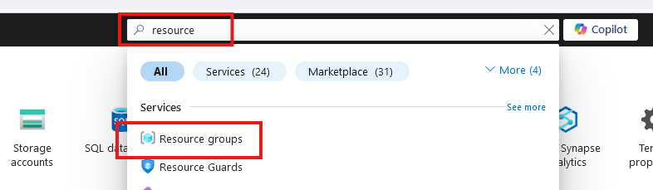
Create Resource Group

Slide 3
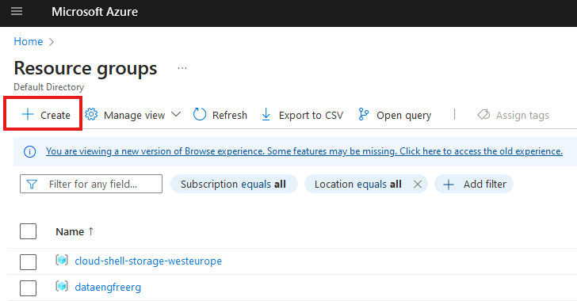
Create Resource Group

Slide 4
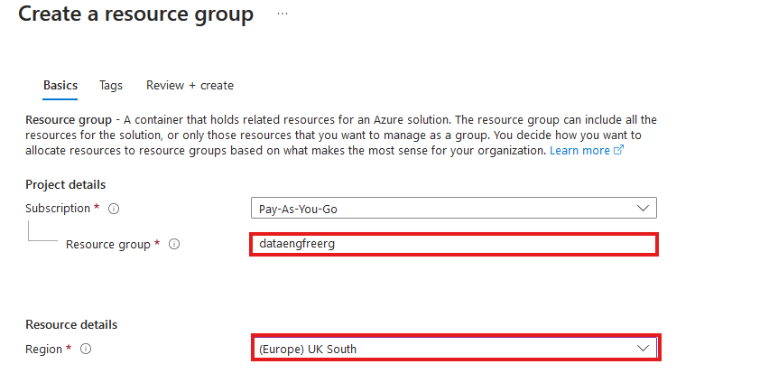
Create Resource Group

Slide 5
VS Code

Slide 6
Azure CLI
Install by following links from: https://learn.microsoft.com/en-us/cli/azure/install-azure-cli
For VSCode:
Azure CLI Tools
Azure Developer CLI
CLI will require extensions for some commands
Automatically downloaded

Slide 7
Azure CLI Demo

Slide 8
Create storage account
Create in same region as RG
Primary service is ADLS Gen 2
Primary workload Big Data Analytics
Performance: Standard
Redundancy: LRS
Add container > RAW directory

Slide 9
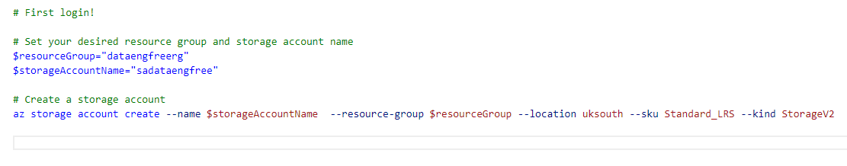
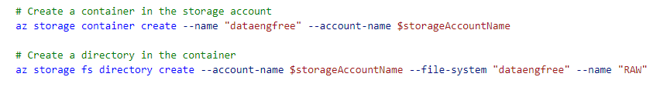
Create storage account

Slide 10
Data & Databases
Concepts to Learn: Data types, databases (SQL and NoSQL), data structures.
Tools/Resources:
Azure SQL Database - free tier available
Cosmos DB: Explore NoSQL databases with a limited free tier on Azure.

Slide 11
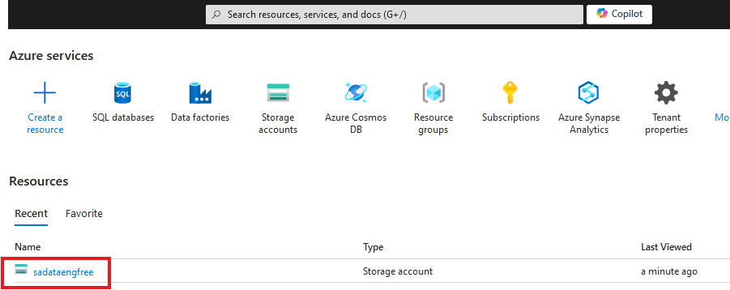

Slide 12
Create Azure Data Factory
Create in same region as RG

Slide 13
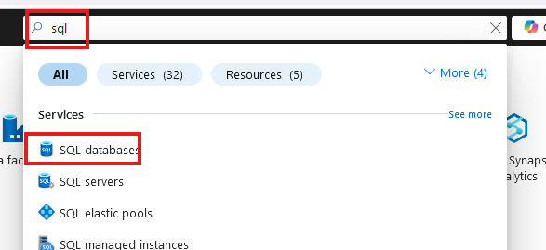
Create SQL database

Slide 14
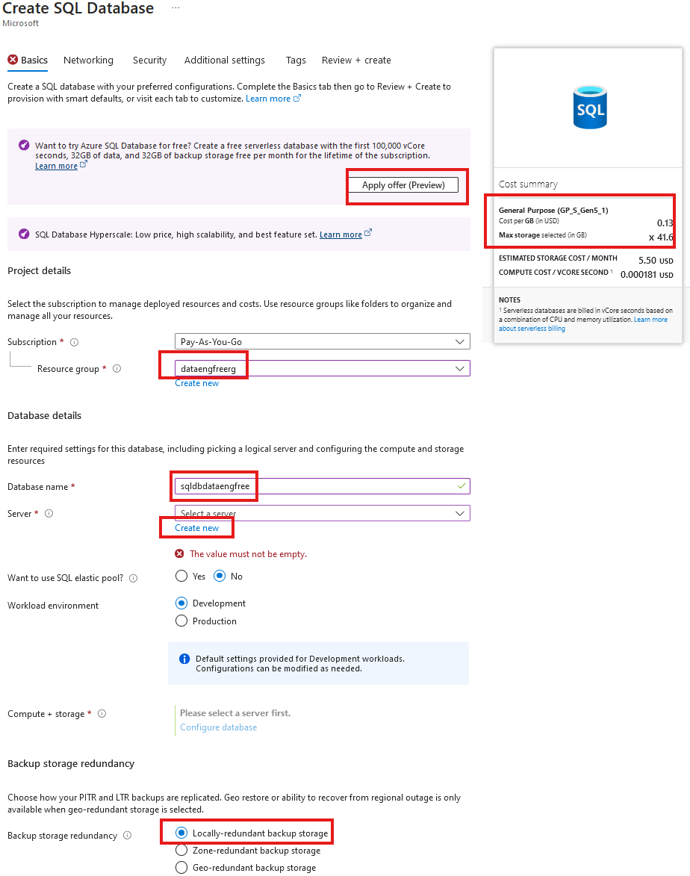
Create SQL database

Slide 15
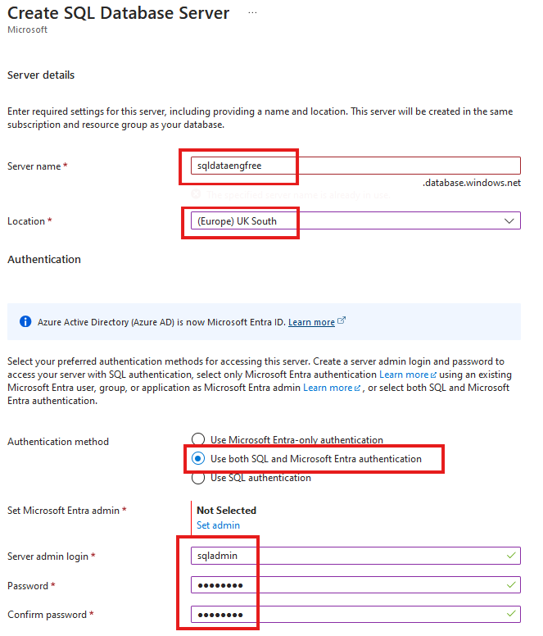
Create SQL database

Slide 16
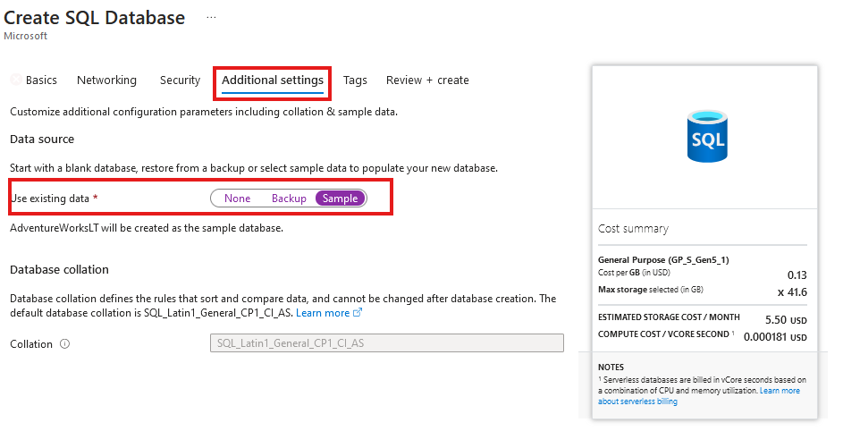
Create SQL database
Add sample data

Slide 17
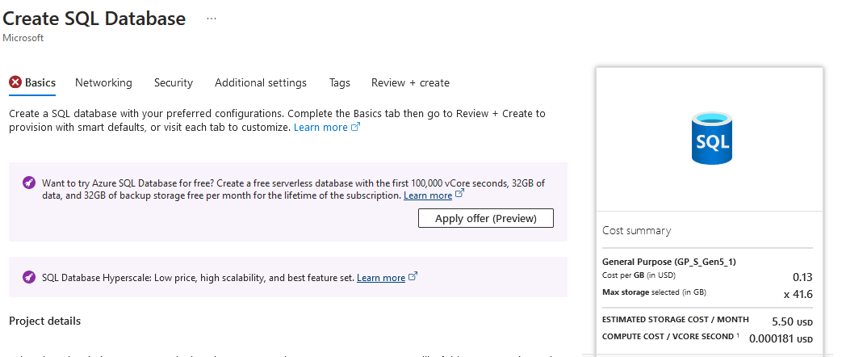

Slide 18
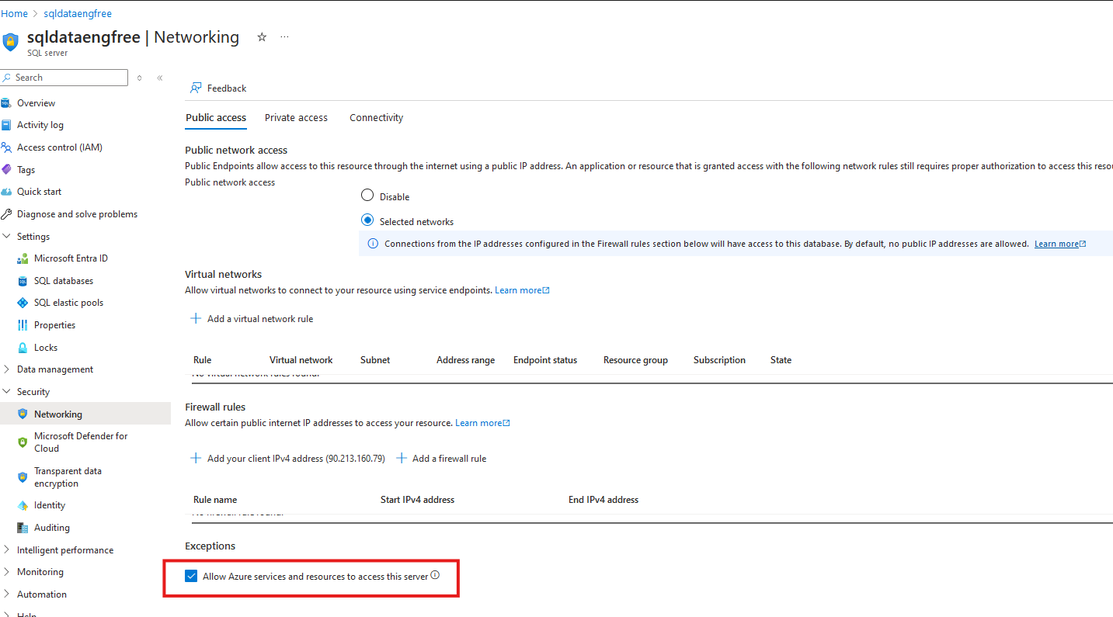

Slide 19
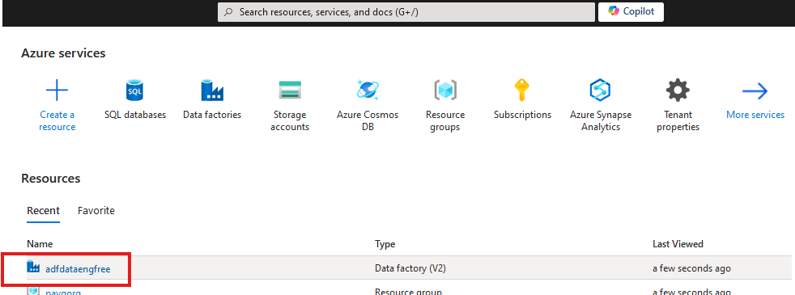


Slide 20
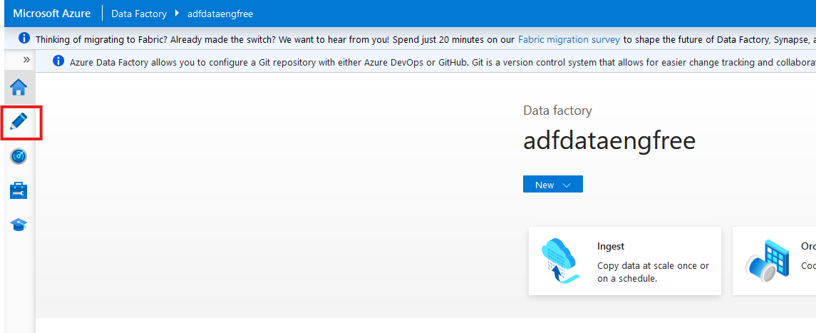

Slide 21
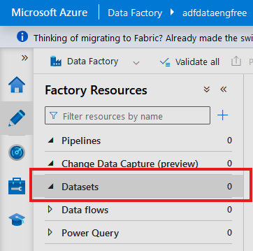
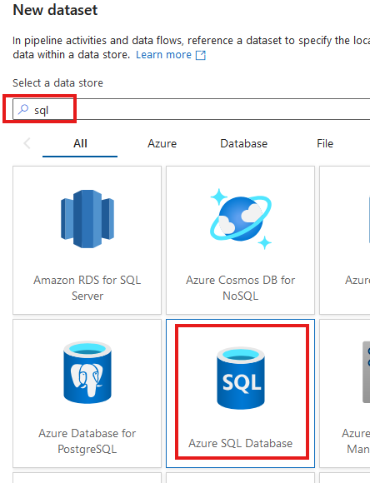

Slide 22
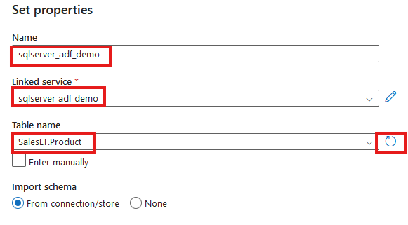

Slide 23
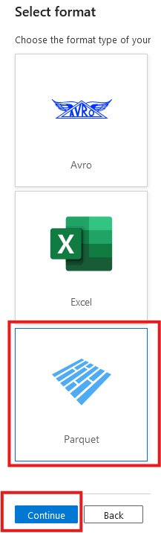
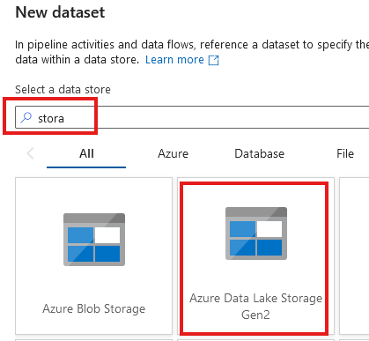

Slide 24
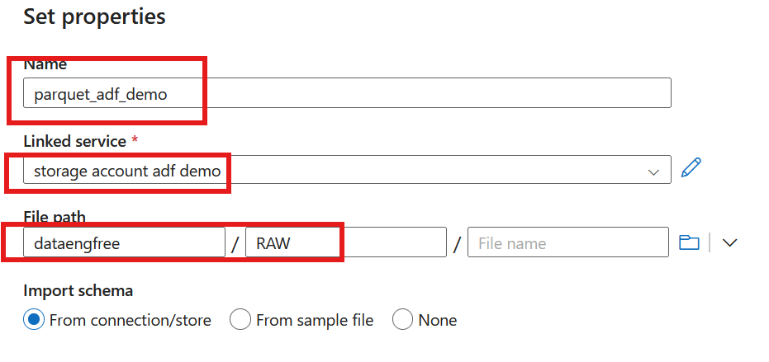

Slide 25
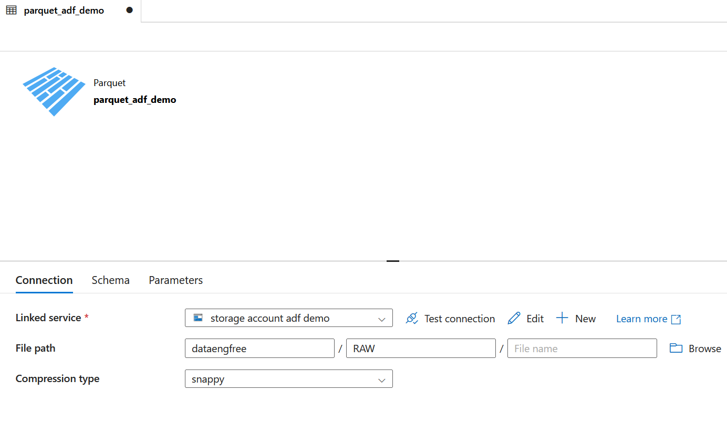

Slide 26
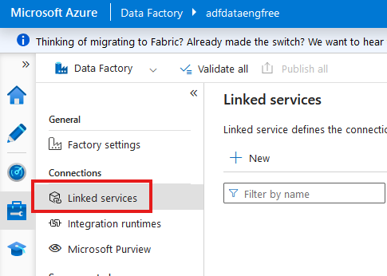

Slide 27
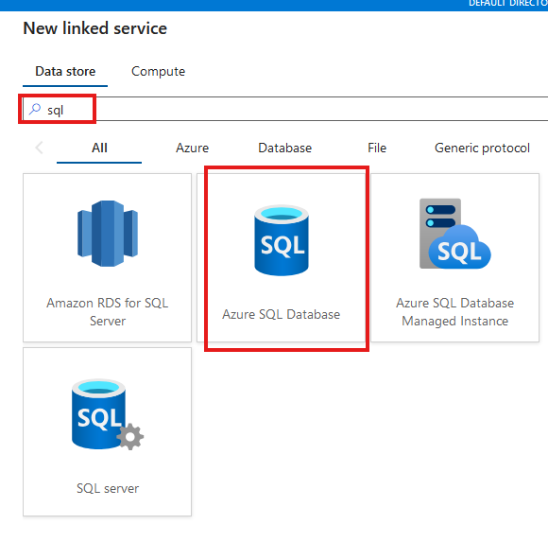

Slide 28
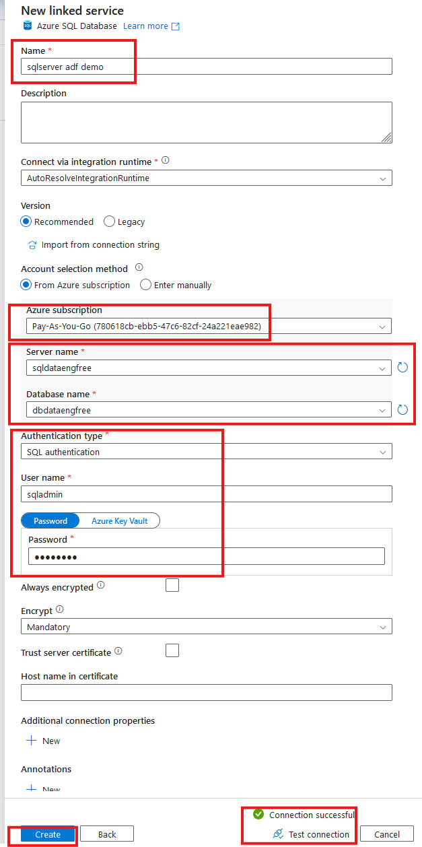

Slide 29
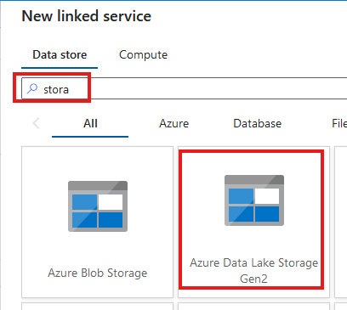
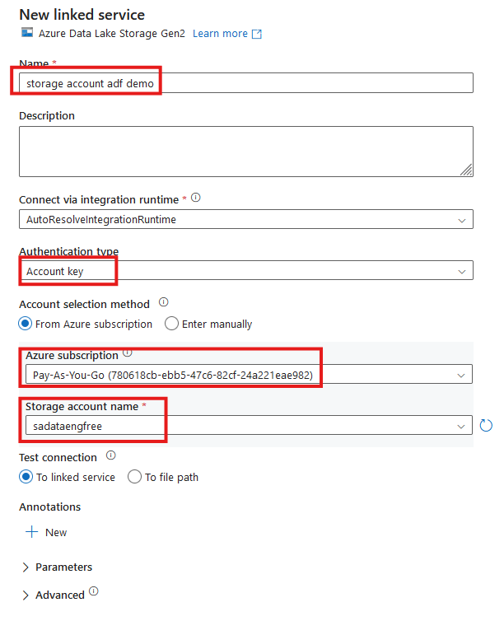


Slide 30
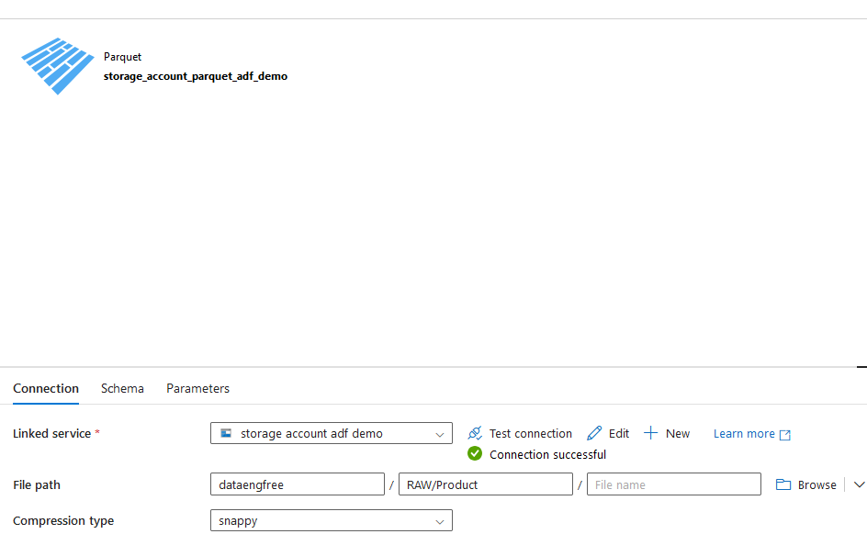

Slide 31
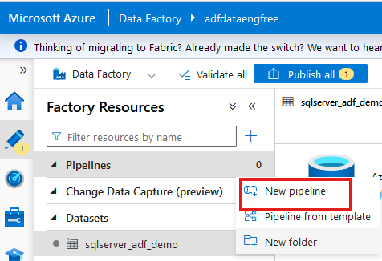
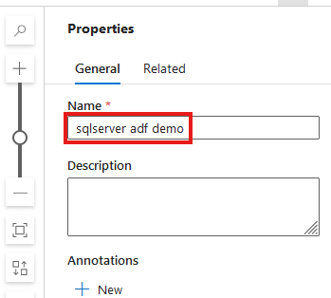

Slide 32
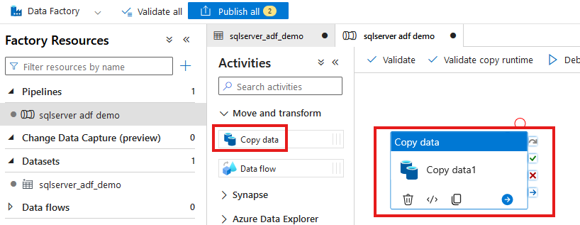

Slide 33
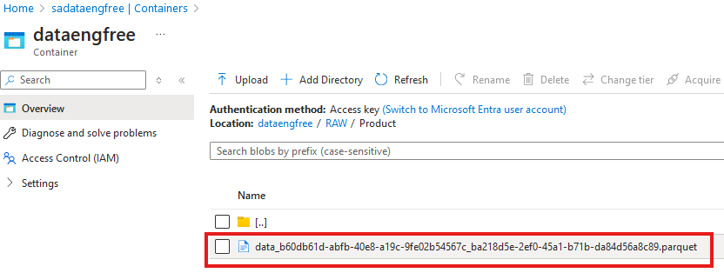

Slide 34
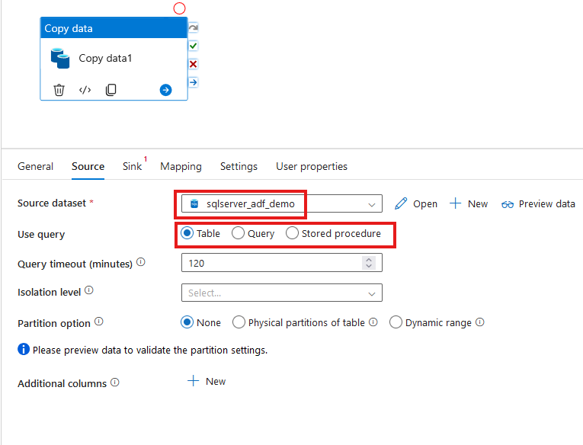

Slide 35
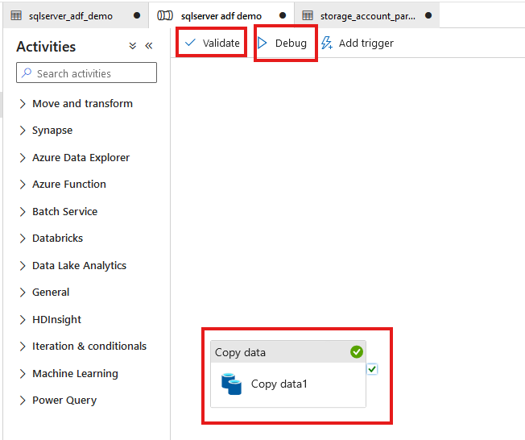

Slide 36
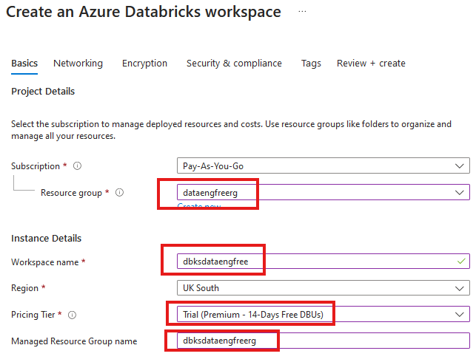


Slide 37
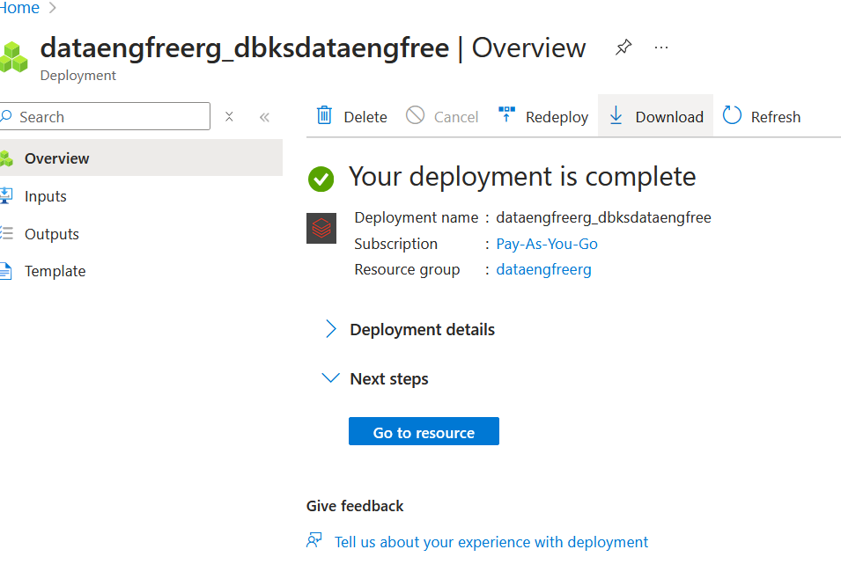

Slide 38
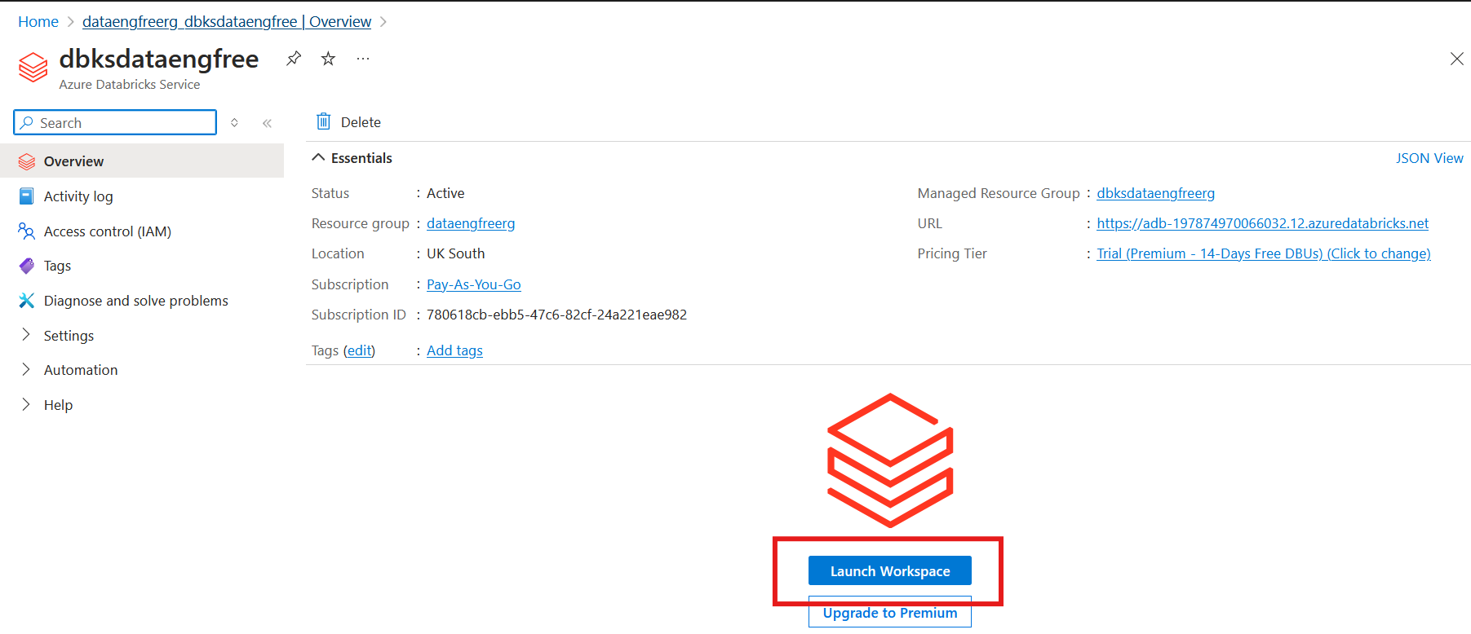

Slide 39
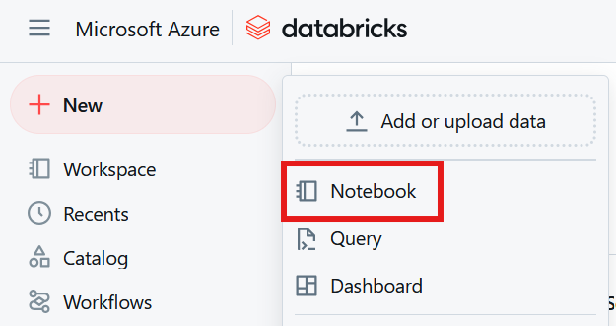

Slide 40
Python
Use Anaconda
Use conda to create environment
Might need to enable Long Paths

Slide 41
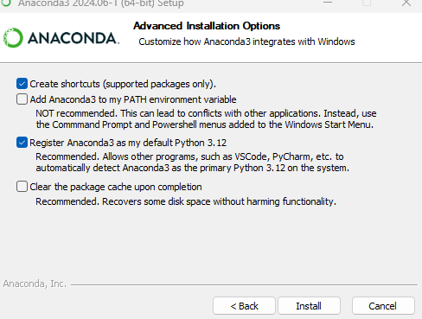
Anaconda install

Slide 42
Conda demo

Slide 43
PySpark Pre-requisites
Install Java (not v 21)
Set paths
JAVA_HOME
PATH
Install Apache Spark
Install winutils.exe
Create virtual environment
Instructions: https://sparkbyexamples.com/pyspark-tutorial/

Slide 44
PySpark Demo
Notes:
PySpark validation
Web UI
VS Code
- to run Jupiter notebooks needs ipykernel installed
- from vscode run conda install -n dataengforfree_env ipykernel
- copy python.exe > python3.exe
Visualisation?

Slide 45
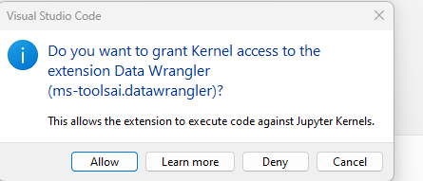

Slide 46
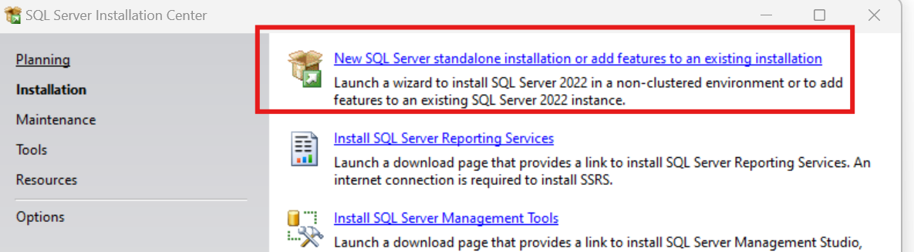
SQL Express!
https://www.microsoft.com/en-us/download/details.aspx?id=104781&lc=1033

Slide 47
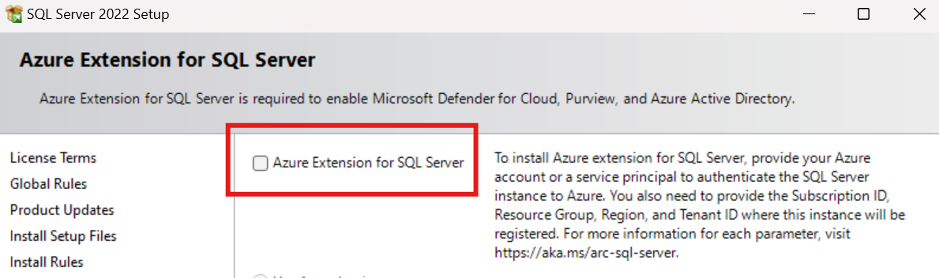
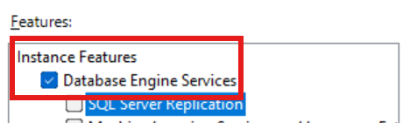
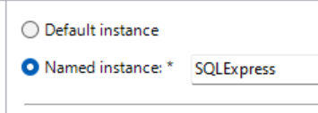

Slide 48
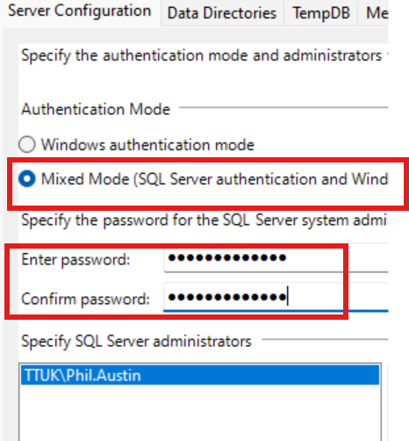

Slide 49
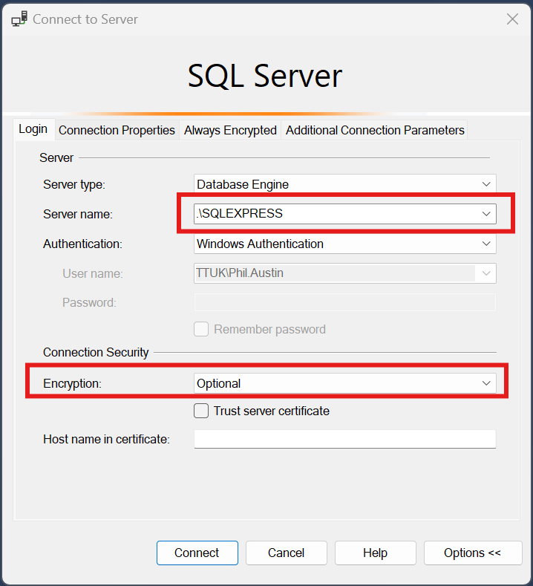

Slide 50
Download JDBC driver: https://repo1.maven.org/maven2/com/microsoft/azure/spark-mssql-connector_2.12/1.2.0/spark-mssql-connector_2.12-1.2.0.jar
Copy jar file to anaconda jars folder

Slide 51
END

Slide 52
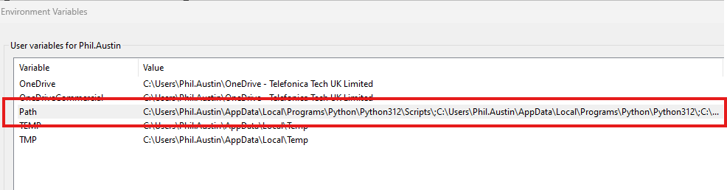
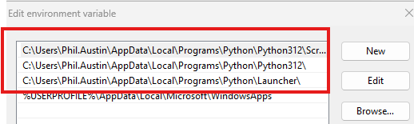
Python pre-reqs

Slide 53
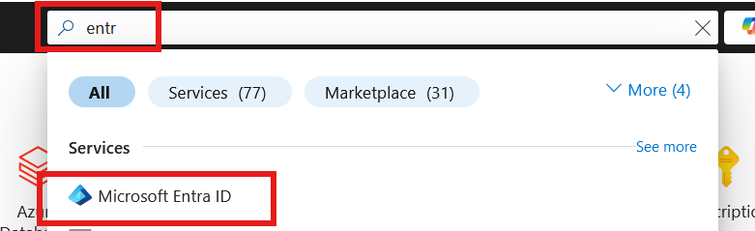
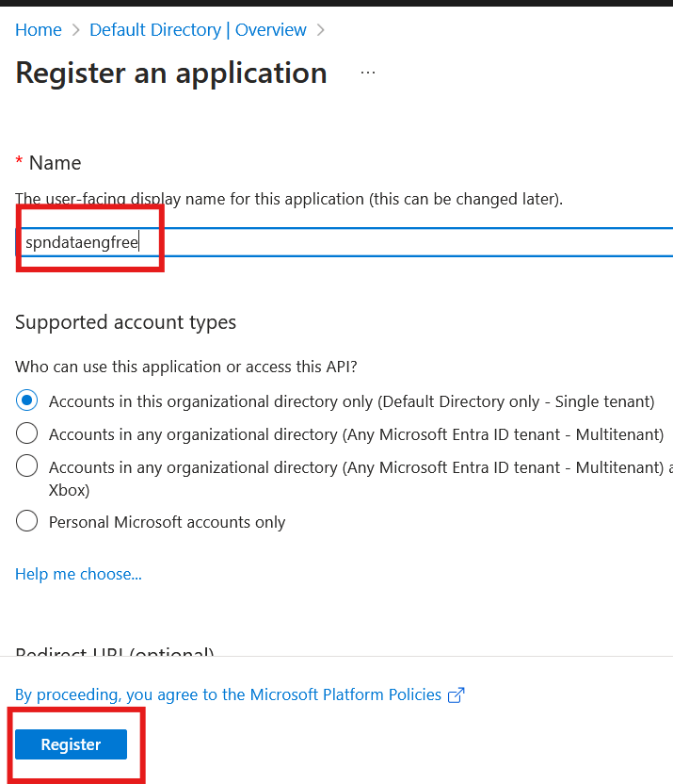

Slide 54
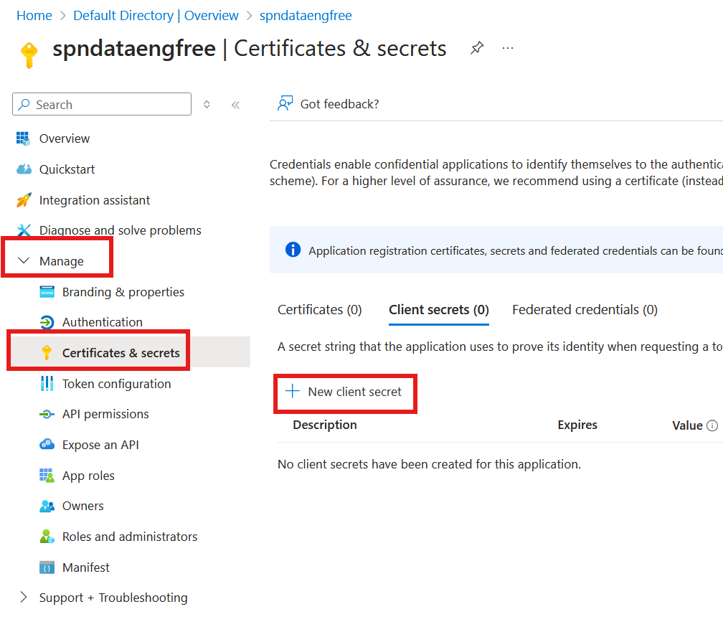


Slide 55



Slide 56


Slide 57

Create storage account

Slide 58

Create storage account

Slide 59

Create storage account

Slide 60



Slide 61


Create Azure Data Factory (ADF)

Slide 62
Create Azure Data Factory (ADF)

Slide 63

Create Azure Data Factory (ADF)

Slide 64


Slide 66
PySpark

